Slide 1
Simple Machines
4th Grade: Science Test Prep

Slide 2
Vocabulary
Force: An interaction that will change the motion of an object. This can be a push or a pull.
Ramp/Inclined: A simple machine with a slanted surface
Levers: A simple machine that will help you lift things by increasing force on an object.
Pulley: A pulley is a simple machine that uses grooved wheels and a rope to raise, lower or move a load.
Wheel and Axle: A wheel with a rod, called an axle, through its center lifts or moves loads.
Screws: A simple machine that is used to hold two things together.
Wedge: A triangular shaped tool, and is a portable inclined place.

Slide 3
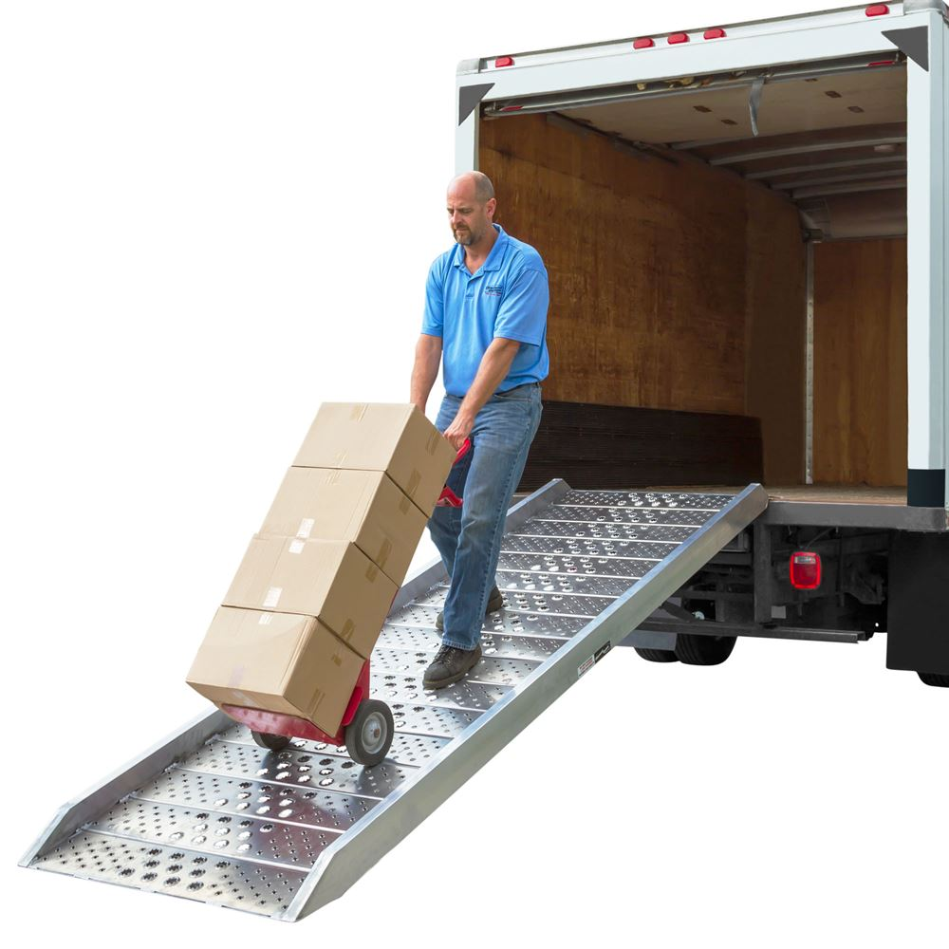
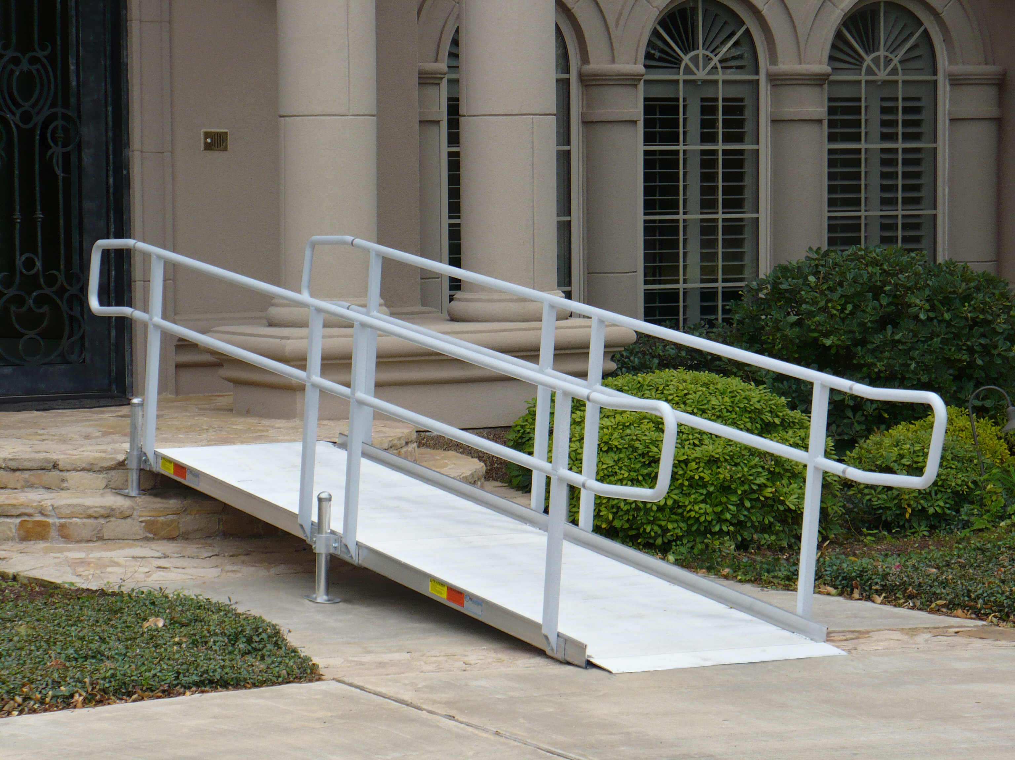
Ramp/Inclined Plane
How can a ramp help you do work?

Slide 4
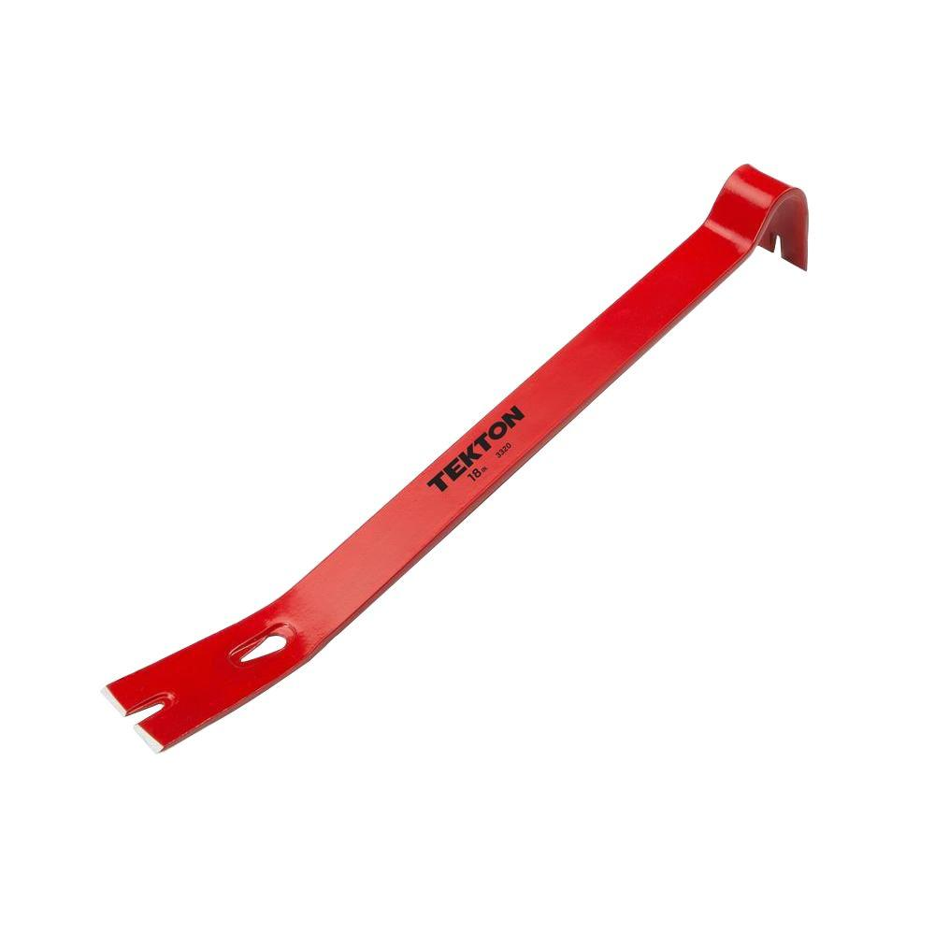
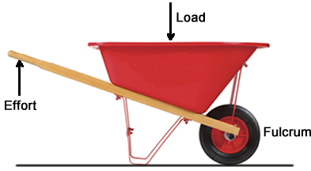
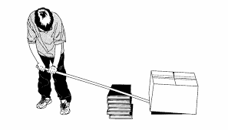
Levers
How can a lever help you do work?

Slide 5
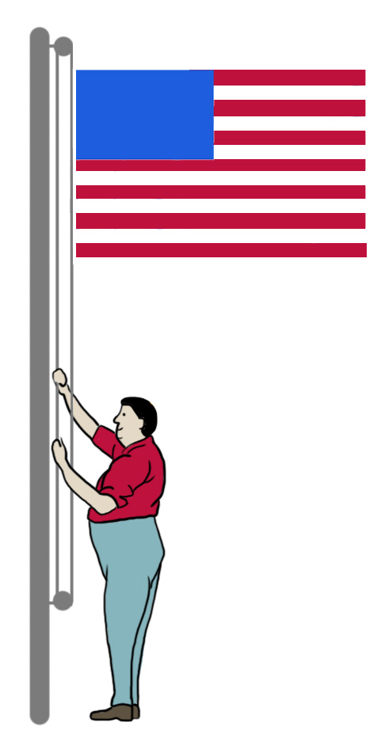
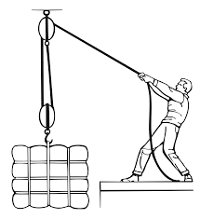
Pulley
How can a pulley help you do work?

Slide 6
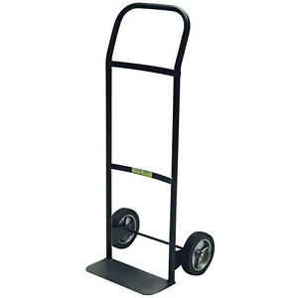
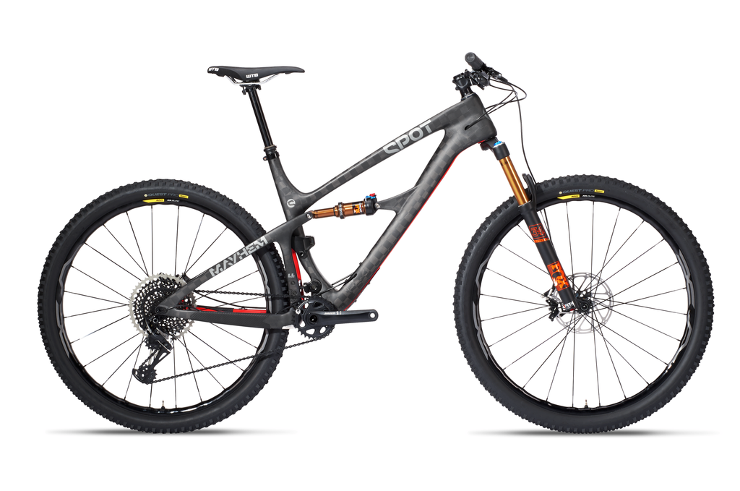
Wheel and Axle
How can a wheel and axle help you do work?

