Slide 1
Water cycle
4th Grade Science Test Prep Mini Lessons

Slide 2
Objective
The water cycle is a way the Earth recycles water. The water circulates between the Earth’s oceans, atmospheres, and land. There are 5 important parts of the water cycle that we are going to learn about today.

Slide 3
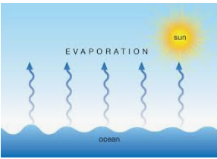
Evaporation
Evaporation happens when water is heated by the sun and turns into water vapor that rises through the air.
Liquid water changes to water vapor which is a gas.

Slide 4
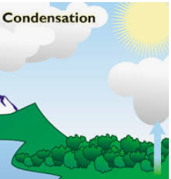
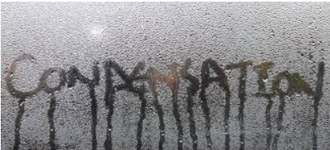
Condensation
Condensation is when water vapor, a gas, turns into a water, a liquid.
Condensation is important to the water cycle because it forms the clouds.

Slide 5
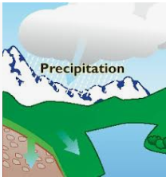
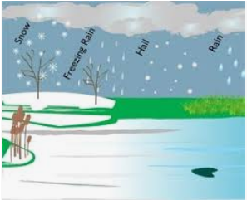
Precipitation
Precipitation is when water is released from the clouds. It comes down from the clouds in the form of rain, freezing rain, sleet, snow, or hail.

Slide 6
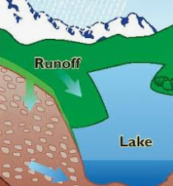
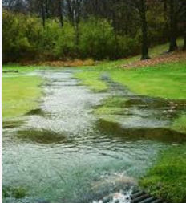
Runoff
Runoff is water flowing on the Earth’s surface.

Slide 7
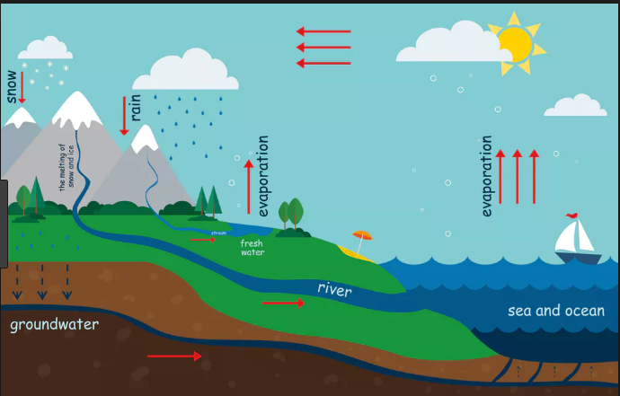
Groundwater
Groundwater is water that moves down into the ground.

Slide 8
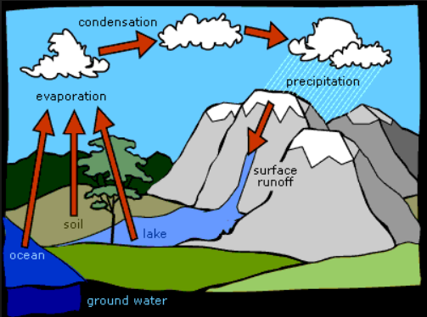
Let’s put it all together

Slide 9
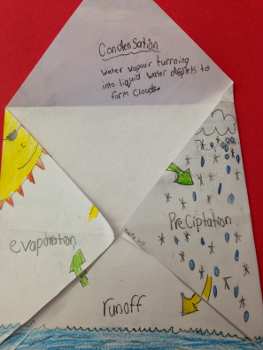
Your Turn!

